Slide 1
Recipe Generator

Slide 2
Contents
Introduction
Aims
Initial Plans and Design
Database Design
Code & Functionality (Tools used)
Tests
Application Demo
Conclusion
Further Questions

Slide 3
Introduction
A Service Orientation Application consisting of 4 services
Utilizing the following technologies:
Python (3.8)
DevOps practices
Continuous integration
Cloud computing and deployment
Agile methodologies
testing
Architecture with
Containerization
Configuration Management

Slide 4
Aims
To Produce:
An cooking application to produce a list of ingredients and a method of cooking to the end-user
Save the User’s recipe to a database
Service orientated application
1 – Frontend
2 – Ingredients Generator
3 – Method Generator
4 – Final Recipe Calculator
Containerization and configuration management
Reverse Proxy Web server

Slide 5
User Stories
Must | Should | Could
As a user who cooks, I would like to be randomly generated a list of up to 6 ingredients so I can think of a meal to cook a | SHOULD: As a User I would like to enter the number of people I am cooking for and be given the number of ingredients needed for the meal so i do not need to work it out myself | COULD As a user I want to only interact with nginx so that I never access any of the applications directly to prevent accidental damage
As a user I would like to have a method of cooking assigned to my ingredients list so I can decide if it makes a recipe | As a User I would like to be able to deploy this application myself so that I can run it on my own computer when I’m hungry
MUST: As a user I would like to be able to save my ingredients and method with a title for future reference so that I can cook it | As a User I never want to see any down time on the online application even when its updating so I can always use it

Slide 6
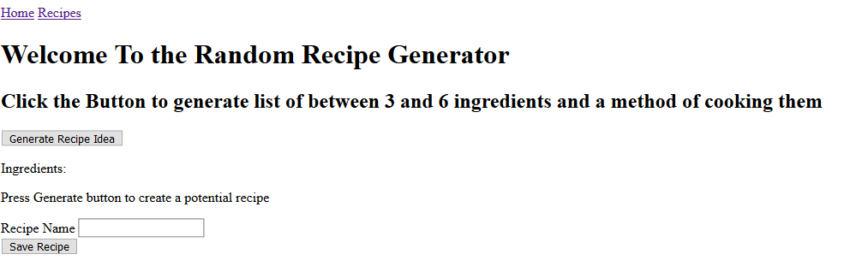
Frontend
Provide Interaction with the user
Very basic front end
SQL Database
Communications

Slide 7
Ingredient Generator
Randomly generates a number between 3 and 6
Randomly generates whether the meal is vegetarian
Ingredients are stored in 2 .csv files, Vegetables and Meat
Randomly Picks between 3 and 6 items from the ingredients csv and returns in a json dump

Slide 8
Method Generator
Methods are all stored within a list within the function
Function reads length of list and generates a number based on number of items inside
Uses Random number generation to pick item out of list
Returns the chosen item as a json dump

Slide 9
Final Recipe Calculator
Using requests, makes a get request to other two services to their reverse proxy
2 ingredients requests
1 Method require
Uses eval to turn json text back into a list.
Counts the number of characters in the combined ingredients and method
Applies logic based on number of characters to either: Add, Remove, replace or keep ingredients

Slide 10
Technology and functions Used
Docker containerization
Ansible
All | Frontend | Ingredient | Method | Recipe
Flask | Jinja2 | Random | Random | Random
Docker | SQL Database | Pandas |  | Requests
Ansible | Requests
Nginx
json

Slide 11
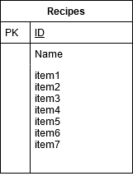
Database Design
Original Design featured 3 tables, Recipes, Methods, Ingredients

Slide 12
Risk Assessment
Risk | Impact | Likelihood | Mitigation
External database access | High | Low | Environmental Variables, Passwords
GCP account security | High | Low | Passwords/ Google also has above average security
Deleting Code | Medium | Medium | Git Repo/ Rewriting code
Deleting user files | Medium | Medium | Users can’t delete recipes on app. Database access locked behind passwords
Losing Scope | High | High | Trello board planning / experience with programming
VM running out of memory | High | High | Added docker pruning to remove unused images
Use of Eval | High | Medium | Personal project unlikely to be accessed by anyone else
Randomness | Medium | Medium | Hard to test random functions are working correctly without statistical analysis

Slide 13
Project Obstacles
Writing tests for cross service interactions
Must fake the connection to test the code
Making requests across services with lists
Json does not suppose lists
Using Eval (which isn’t good practice)
Docker Containers and images taking up too much space on VMs
Notes:
Night before it was due Jenkins crashed unexpectedly. Solved by freeing up memory so that it could run. In future set up a docker prune clause to remove un-used images

Slide 14
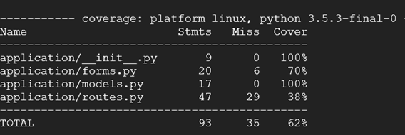
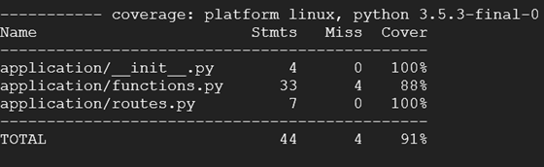

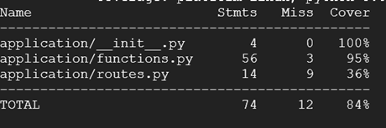
Service | Results | Number of pytest tests
Frontend |  | 2
Ingredients |  | 2
Method |  | 1
Recipe |  | 11

Slide 15
Live Demo: http://35.246.44.85/

Slide 16
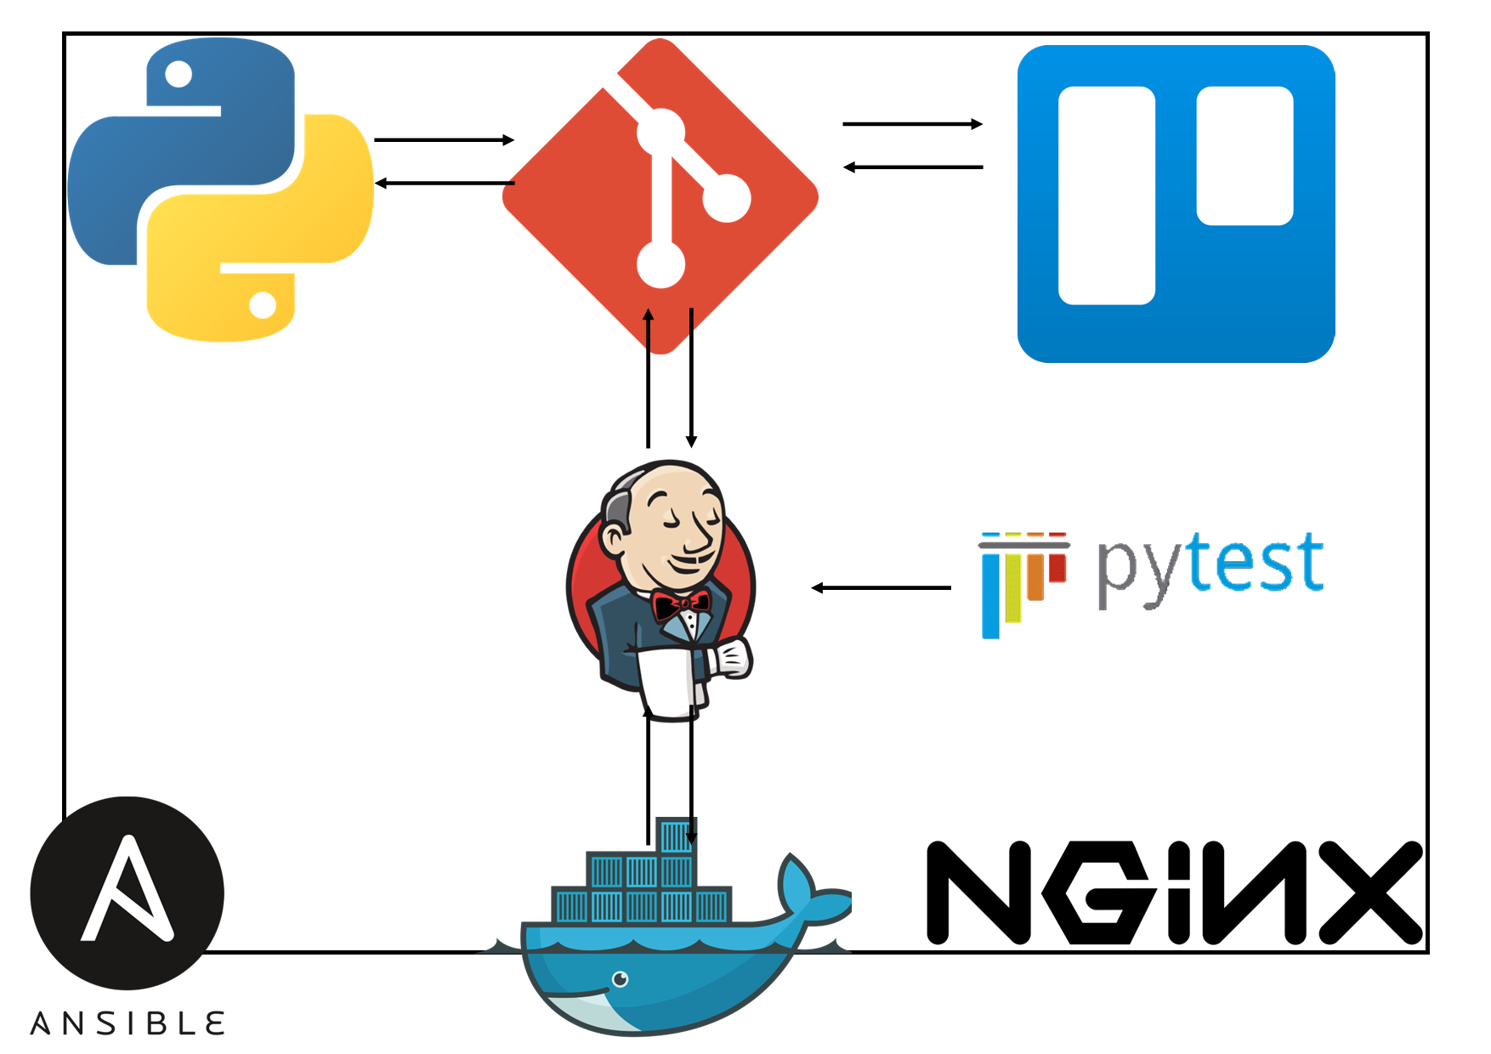

Slide 17
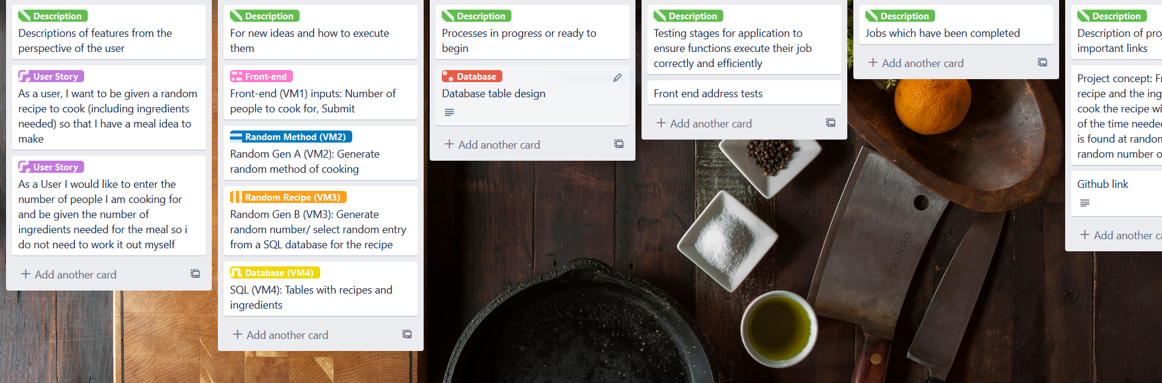
Trello initial setup

Slide 18
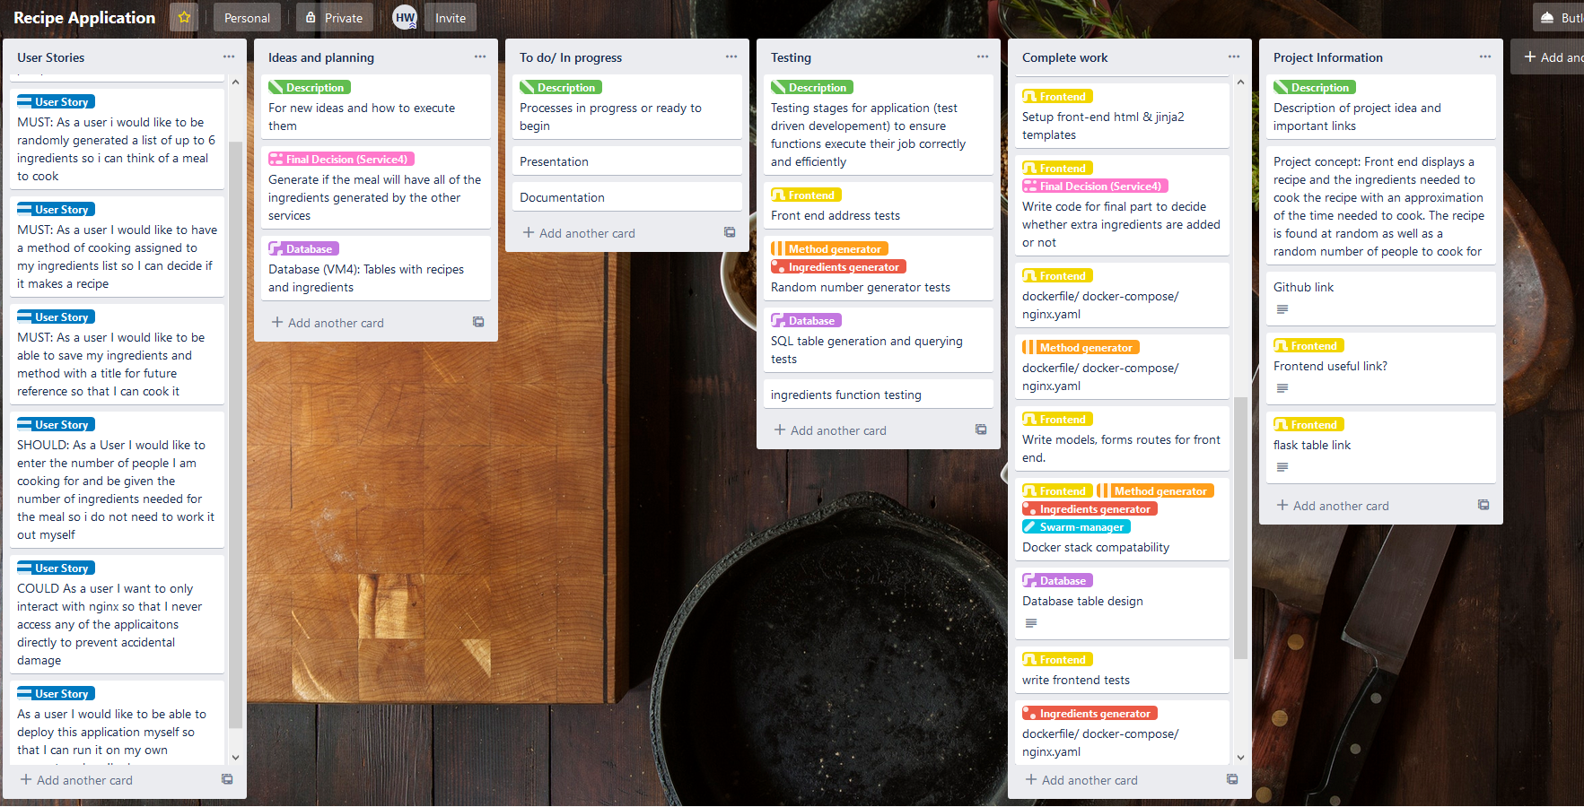
Trello Final

Slide 19
Conclusion
Stretch Goals: User can select if they want a vegetarian meal themselves if they never want meat
- User can blacklist ingredients they are allergic to
Development Process
Changes to original plan
Scope/ goals met
Further improvements/ Quality of life changes
User Options
Random recipe saved fix

Slide 20
Further Questions

